Slide 1
Trusts Law
Week 13: Non-fiduciary duties
Dr Johanna Jacques

Slide 2

Last week and this week
Last week:
We looked at trustees’ duties in their capacity as fiduciaries. We also covered associated remedies.
This week:
We will look at trustees’ duties in their capacity as trustees. We will cover associated remedies next week.

Slide 3
Last week: Boardman v Phipps
Boardman v Phipps [1967] 2 AC 46
T’s
Boardman, solicitor (claimant)
Agency, advice
COMPANY
Trust owns 27% of
B’s; including John Phipps (respondent) and Tom Phipps
Boardman and Tom Phipps purchase remaining shares

Slide 4
A trustee’s overriding duty
This week: Trustee duties
CARRY OUT THE TRUST IN ACCORDANCE WITH THE TERMS OF THE TRUST INSTRUMENT

Slide 5

Duties from the general law of trusts
The duty of trustees to familiarise themselves with the terms of the trust and ensure that their appointment was properly made.
The duty to inquire about the past and present business of the trust.
The duty of personal service.
The duty to exercise discretion properly.
The duty to act unanimously.
The duty to keep proper financial accounts and records.
The duty to provide information to beneficiaries.
The duty of care.
The duty to have regard to the standard investment criteria and the duty to review.
The duty to obtain and consider advice.
The duty to act in the best interests of the beneficiaries.
The duty of impartiality.

Slide 6

Investments
The general power of investment, s 3(1) TA 2000:
“A Trustee may make any kind of investment that he could make if he were absolutely entitled to the assets of the trust.”
What is an investment?
  Investment products that provide income, an increase in capital value or both; or
  Other property that provides an income or is anticipated to rise in value.

Slide 7
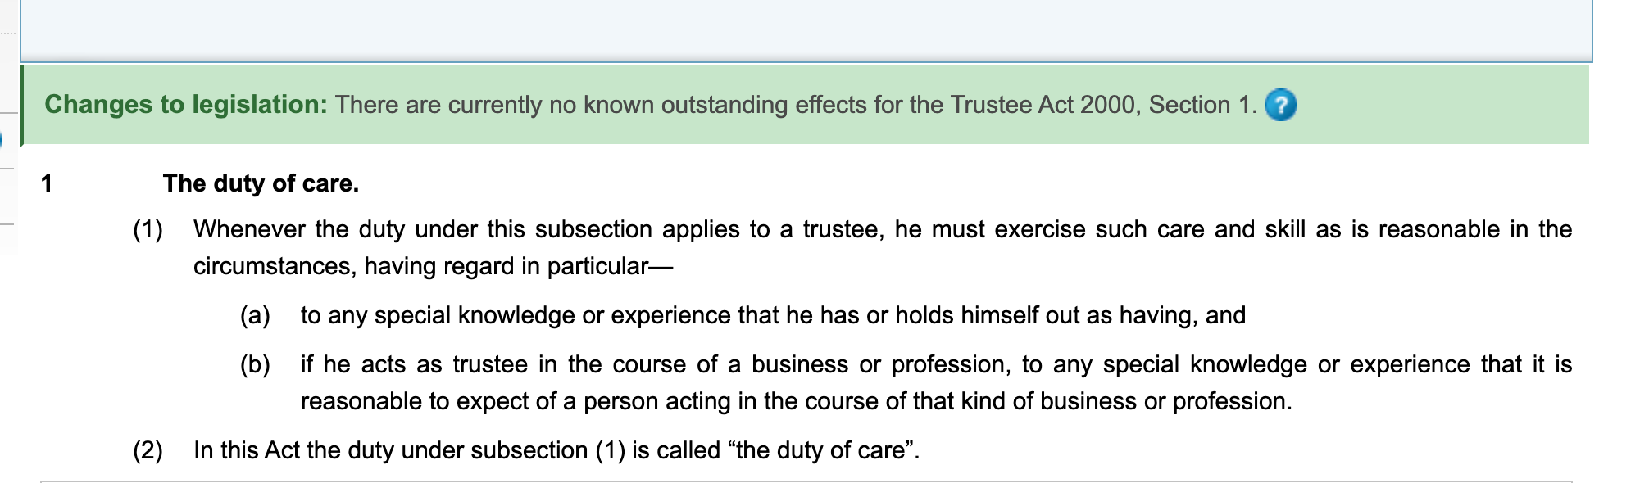
The duty of care
But note the power to exclude in Schedule 1(7) TA 2000!

Slide 8
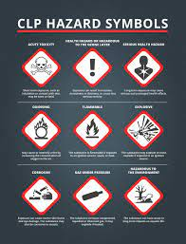
The standard of care: Prudence
The ‘prudent man of business’ (Speight v Gaunt).
Learoyd v Whiteley, Court of Appeal: Investing for yourself is nothing like investing for another.
Learoyd v Whiteley, House of Lords: “. . . to avoid all investments of that class which are attended with hazard.”

Slide 9
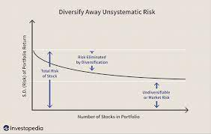
The duty of care and Modern Portfolio Theory (MPT)
Bartlett v Barclays Bank: Prudent businessmen take risks.
Nestle v NatWest: “An investment which in isolation is too risky and therefore in breach of trust may be justified when held in conjunction with other investments.”
Trustees of the British Museum v AG: More risks appropriate for larger funds.

Slide 10

The duty of care and different types of trustees
Standard is variable (see s 1(1) TA 2000).
Continuous balancing act between:
  Justifiably high expectations of professional trustees;
  Trustees being made to insure investment performance;
  Costs.
Exclusion clauses are now the norm.

Slide 11



The duty of care in practice
Re Chapman [1896] 2 Ch 763
Nestle v National Westminster Bank Plc [1993] 1 WLR 1260
Bartlett v Barclays Bank Trust Co Ltd [1980] Ch 515

Slide 12
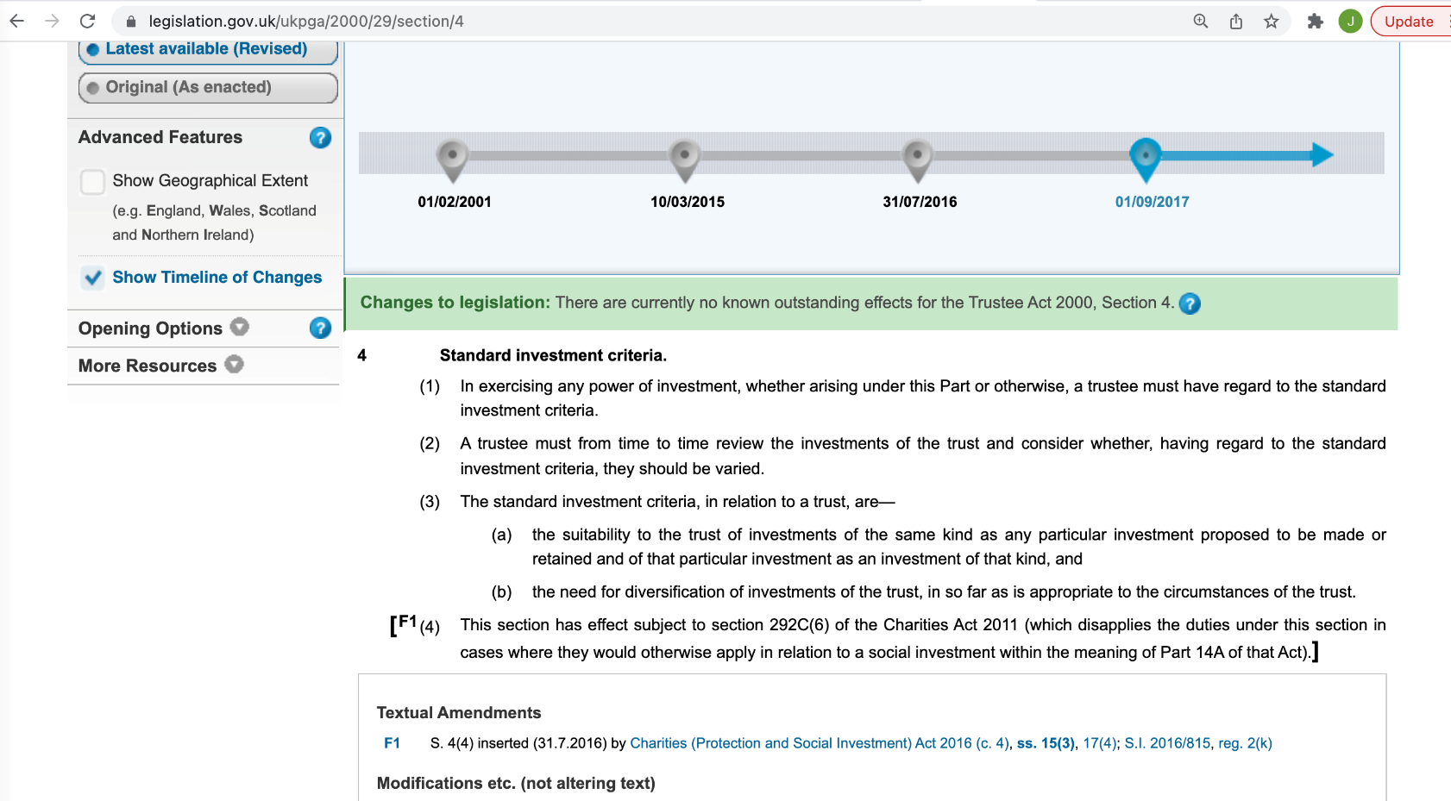
The duty to have regard to the standard investment criteria and the duty to review

Slide 13
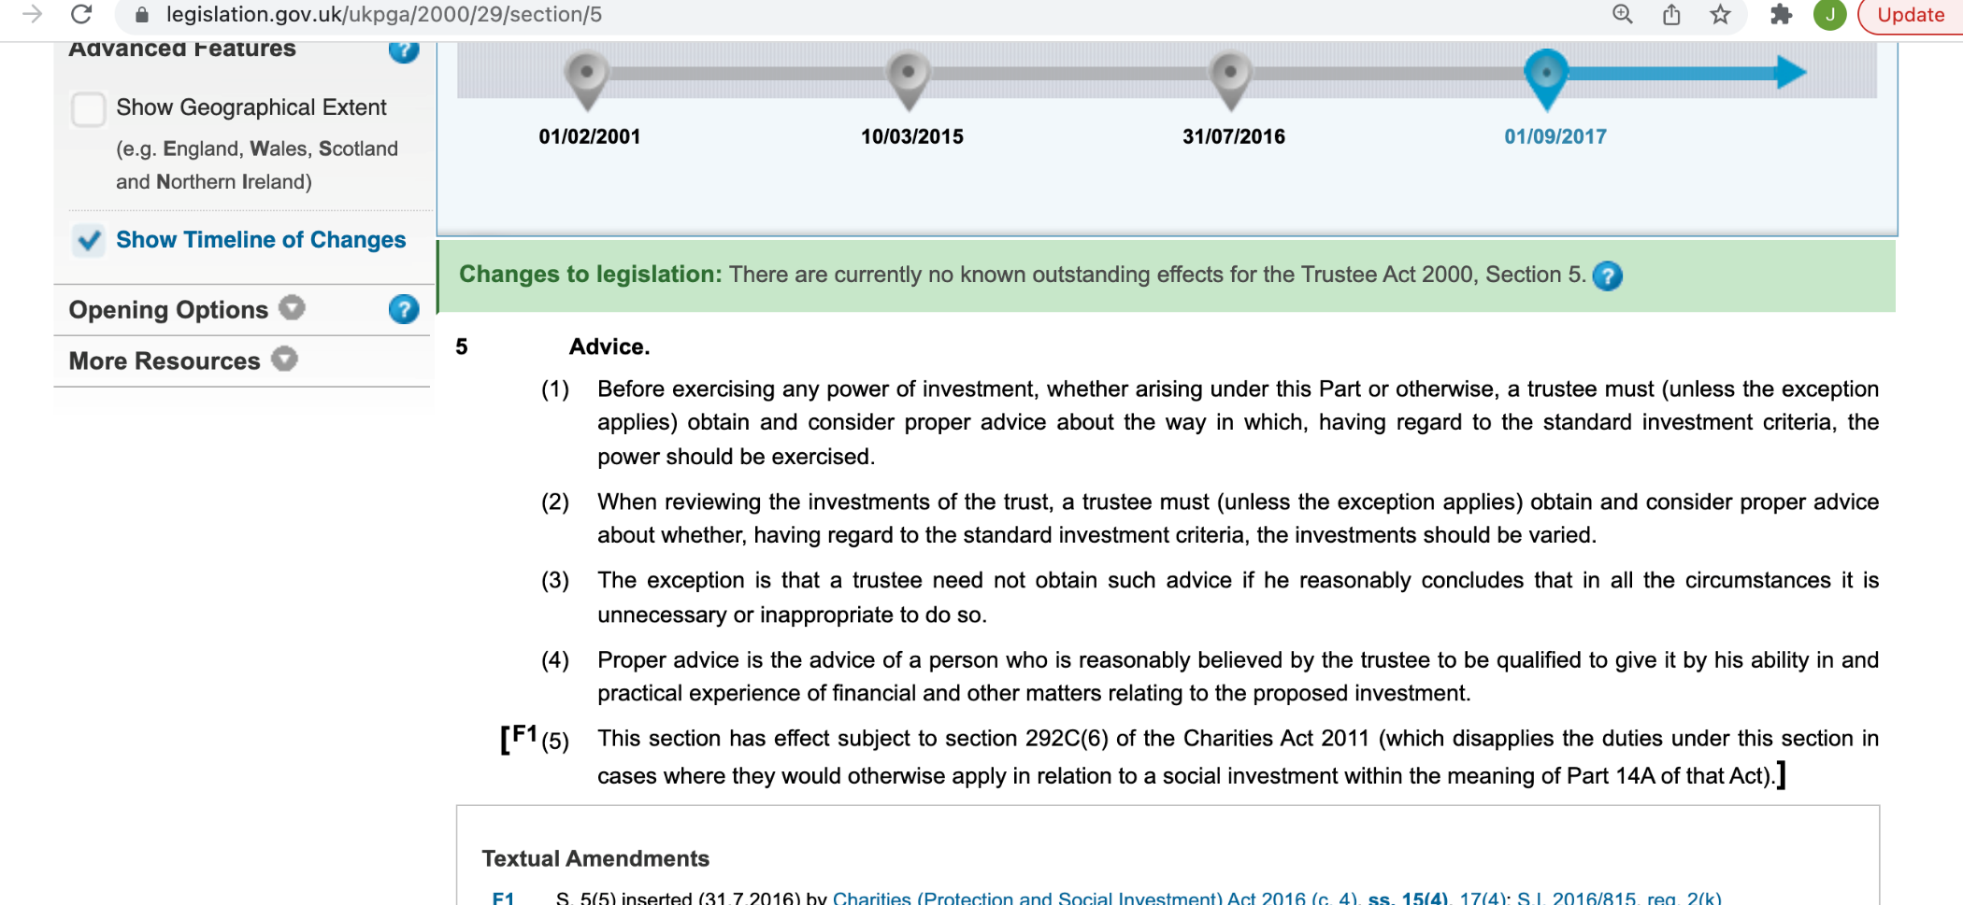
The duty to obtain and consider advice

Slide 14

The duty to act in the best interests of the beneficiaries
Financial vs. non-financial: Cowan v Scargill [1985] Ch 270
Purpose of the trust? Merchant Navy Ratings Pension Fund Trustees Ltd v Stena Line Ltd and others [2015] EWHC 448 (Ch)
ESG investments: Harries v Church Commissioners [1992] 1 WLR 1241; Butler-Sloss v The Charity Commission [2022] EWHC 974 (Ch)

Slide 15

The duty of impartiality
Life tenants vs. remaindermen.
Duty to invest, but no duty to convert if not intended by the settlor.
Fair balance ≠ equality.
Nestle v National
Westminster Bank Plc.
Does not apply to discretionary
Powers.

Slide 16
“Lord Chancellor Cottenham once deemed any man who would accept a trusteeship a second time fit only for a lunatic asylum”
(Moffat’s Trusts Law)

Slide 17
Recap
In addition to fiduciary duties, trustees are also subject to non-fiduciary duties.
Of these, we have discussed the duties most relevant to investment decisions (except for delegation).
While a stringent duty of care arises, in practice a breach is difficult to litigate.

Slide 18

Activity
‘Greenwashing’ refers to firms making untrue statements about their climate credentials. The Financial Conduct Authority has introduced rules on greenwashing for the financial services sector (ESG – the Environmental, Social and Governance sourcebook).
Alongside these rules, the FCA has also issued guidance that gives examples of good and bad practice. You can find the guidance here. Have a look at the example boxes only, starting on page 8. This should give you an idea of the aim of these rules.

